Slide 1

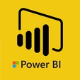
Hii,
Iam Siddhika
Welcome to Power BI Series
Part -47

Slide 2



We focus only on the most used and important Dax Functions
Today Content
Meet DAX
I’m soo Excited. It’s my favourite functions.
Are you ready guys?
COMMON FUNCTION CATEGORIES
7.TIME INTELLIGENCE FUNCTIONS
DATESYTD DATESMTD DATESQTD

Slide 3


DATESYTD
DATESYTD is used to return dates from the start of the year to the current date, which helps in calculating year-to- date values.
You can specify a different year-end date to align with a fiscal year.
It's often used with CALCULATE to sum or aggregate values year-to-date.
Check this
Syntax
DATESYTD(<dates> [,<year_end_date>])
dates: A column containing dates.
year_end_date (optional): A string literal with the year-end date. By default, this is December 31

Slide 4

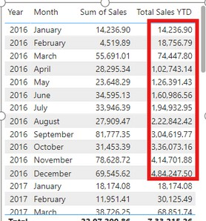
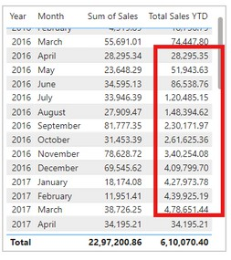
VISUAL EXAMPLE
How can you create a measure to calculate the total sales amount year-to- date using the Order table and the OrderDate column using DATESYTD?
Got it?
SUM(Orders[Sales]): The expression to sum the sales amounts.
DATESYTD(Orders[OrderDate]): Returns a table with dates from the start of the year to the current date.
Year: The year part of the OrderDate. Month : The Month part of the OrderDate.
Sum of Sales: The sum of Sales for each year.
Total Sales YTD: The sum of Sales from the start of each year to the end of each year.
in this visual, you can see:
2016 jan Total YTD = 14,236,90 which is same sum of sales
2016 feb Total YTD= 18,56,79 which is sum of sales(2016 jan +2016 feb) like this it do the sum to end of the year, and for the next year it sums from the 1 jan to dec 31st
If your fiscal year ends on March 31, you can specify this date in the DATESYTD function.
Year: The year part of the OrderDate.
Sum of Sales: The sum of Sales for each year. Total Sales YTD: The sum of Sales from the start of each year and the month april 1st to the end of each year and month march 31.

Slide 5

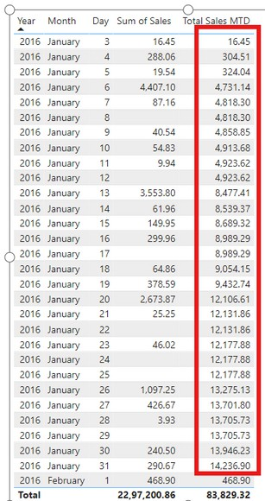

DATESMTD
DATESMTD is used to return dates from the start of the current month to the current date, which helps in calculating month-to-date values.
It's often used with CALCULATE to sum or aggregate values month-to-date.
Easy?
DATESMTD(<dates>)
Example
How can you create a measure to calculate the total sales amount Month-to-date using the Order table and the OrderDate column using DATESMTD?
Syntax
dates: A column containing dates.
Year: The year part of the OrderDate. Month : The Month part of the OrderDate.
Sum of Sales: The sum of Sales for each year.
Total Sales MTD: The sum of Sales from the start of each month to the end of each month. in this visual, you can see:
2016 jan Day 1 Total MTD =16.45 which is same sum of sales (2016 jan Day 1)
2016 jan Day 2 Total MTD= 304.51 which is sum of sales(2016 jan Day 1 +2016 jan Day 2 ) like this, it do the sum to end of the Month, and for the next Month it sums from the 1 jan to jan 31st and vice versa.

Slide 6
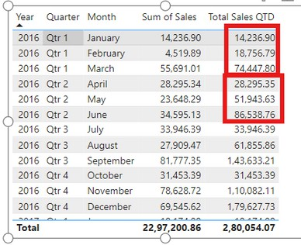

DATESQTD
DATESQTD is used to return dates from the start of the current quarter to the current date, which helps in calculating quarter-to-date values.
It's often used with CALCULATE to sum or aggregate values quarter-to-date.
Understood?
Syntax
DATESQTD(<dates>)
dates: A column containing dates.
_{Example} How can you create a measure to calculate the total sales amount Quarter- to-date using the Order table and the OrderDate column using DATESQTD?
Year: The year part of the OrderDate. Quarter : The Quarter part of the OrderDate. Month : The Month part of the OrderDate.
Sum of Sales: The sum of Sales for each year.
Total Sales MTD: The sum of Sales from the start of each Quarter to the end of each Quarter.
in this visual, you can see:
2016 qtr 1 jan Total QTD =14,236,90 which is same sum of sales (2016 qtr 1 jan )
2016 qtr 1 feb Total QTD = 18,756,79 which is sum of sales(2016 qtr 1 jan + 2016 qtr 1 feb ) like this, it do the sum to end of the Quarter, and for the next Quarter it sums from the april to jun and vice versa.

Slide 7


Thank you for joining me today to learn about Part -47 of Power BI!
Remember, Learning DAX is key to unlocking the full potential of Power BI for insightful reporting and visualization.
Stay tuned for more insights and tips on Power BI in our next Series.
Follow
Siddhika Shah

